Slide 1
ENGI 301 Wearable Metronome Proposal
10/15/2019
Hoang Vu

Slide 2
Background Information
A wearable metronome/sound sensor, functions include:
Vibrates at a set tempo
LED patterns according to noise level
Optional (different mode for different rhythms/scales)
Advantage: replace traditional sound metronome with vibrational indication direct to musicians
Do not interfere with recording
Usable in loud noise situation

Slide 3
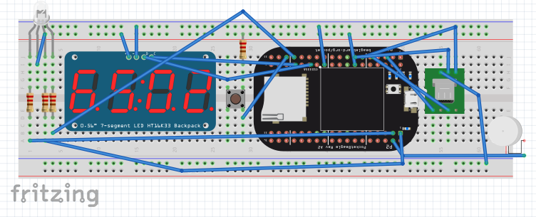
System Block Diagram
PocketBeagle
PWM0BPWM1A
PWM2B
LED + 680 Ohms resistor
Power Bank
USB Port
GPIO58
Vibrational Motor
Microphone
(through microusb breakout board and audio adapter
3.3V
GPIO117
Multifunctional Button
USB1
I2C2
GND
330 Ohms Resistor
4-digit 7-segment Display

Slide 4
Power Block Diagram
PocketBeagle
3.3V
PWM0BPWM1A
PWM2B
LED + 680 Ohms resistor
5V
3.3V
Power Bank
USB Port
GPIO58
Vibrational Motor
85 mA
Microphone
(through microusb breakout board and audio adapter
3.3V
GPIO117
Multifunctional Button
USB1
I2C2
GND
330 Ohms Resistor
4-digit 7-segment Display

Slide 5
Fritzing Diagram

Slide 6
Components / Budget
Component | Need to Buy | Cost
PocketBeagle | No | $22.56
Small vibrational motors | No | $7.99/5
Microroller switch | No | $0.10
LED | Yes | $0.10
4-digit 7-segment LCD Display I2C Adafruit | No | $19.95
Microphone USB Clip-on | Yes | -
10,000 mA power bank | Yes | -
Universal Sport Armband | No | -

